Slide 1
Hospital Cabin and ICU booking System
CSE471-System Analysis & Design

Slide 2
Group: 02(Sec-02)
Members Name and Id:
Jawad Bin Jalil(18321004)
Sugata Saha(18301089)
MD. Abdul Kahhar Siddiki Shan(18301221)
Presented to:
Afrina Khatun
Nasif Noor Saleheen

Slide 3
Contents:
Contribution Of Members
For instance
Planning
Analysis
Design
Analysis of Current System
Analysis of Proposed System
UML diagram
Summary & conclusion

Slide 4
Contribution Of Members:
Name | ID | Activity
MD. Abdul Kahhar Siddiki Shan | 18301221 | Motivation, System request(Business values) Requirement Analysis, Sequence diagram (admin), State Machine diagram(admin), Data Flow diagram
Sugata Saha | 18301089 | Introduction, System request(Business requirements), Use Case diagram, Activity diagram
Jawad Bin Jalil | 18321004 | System request(Business needs, Special issues and constrains), Sequence diagram (user), State Machine diagram(user), Windows Navigation diagram, Conclusion

Slide 5
For instance
Medical facilities of Bangladesh
To give medical facilities to every people of Bangladesh as soon as possible
To book cabin and ICU by sitting at home.

Slide 6
Planning
70% of population lives in rural area where health sector is urban centered.
Lacking of Cabin & ICU beds.
Covid-19 pandemic.
Profitable(Proposed annual profit >= 4000000 taka)
Do not have any online service regarding Cabin and ICU booking.

Slide 7
Analysis
This system provides helps to book ICU beds and Cabins.
Our system provides service in every district in our country.
User can book anytime as we provide 24*7 hour service.
Admin panel controls the whole system.
The system is supported by both web, Android & IOS operating system.

Slide 8
Design
The system will be designed through website and mobile application.
User have to login with proper email address and password.
We will store our data in ORACLE database.
User’s information will be secured.
This will maintain cultural and political constrains.

Slide 9
Analysis of Current System
1. Lack of ICU specialists.
2. Not accessible to general public.
3. Do not have proper information about charge other necessaries.
4. Covid-19 pandemic.
5. Not enough service during emergency period.
6. Rural people are the worst victims.
7. We do not have any online service regarding Cabin and ICU booking.

Slide 10
Analysis of Proposed System
1. Launching the first Online Hospital and ICU Booking System in Bangladesh.
2. One point home service.
3. Options to choice various types of hospitals.
4. Provide 24 * 7 hours service.
5. Approach to save a lot of lives.
6. Future plan of launching air ambulance and home medicine delivery service.
7. Determined to follow Digital Activity Law.

Slide 11
Requirement analysis
Functional Requirement:
1. Log In Database.
2. Admin.
3. Users.
4. Rating system.

Slide 12
Non-functional
Operational,
Performance,
Security,
Cultural and Political.

Slide 13
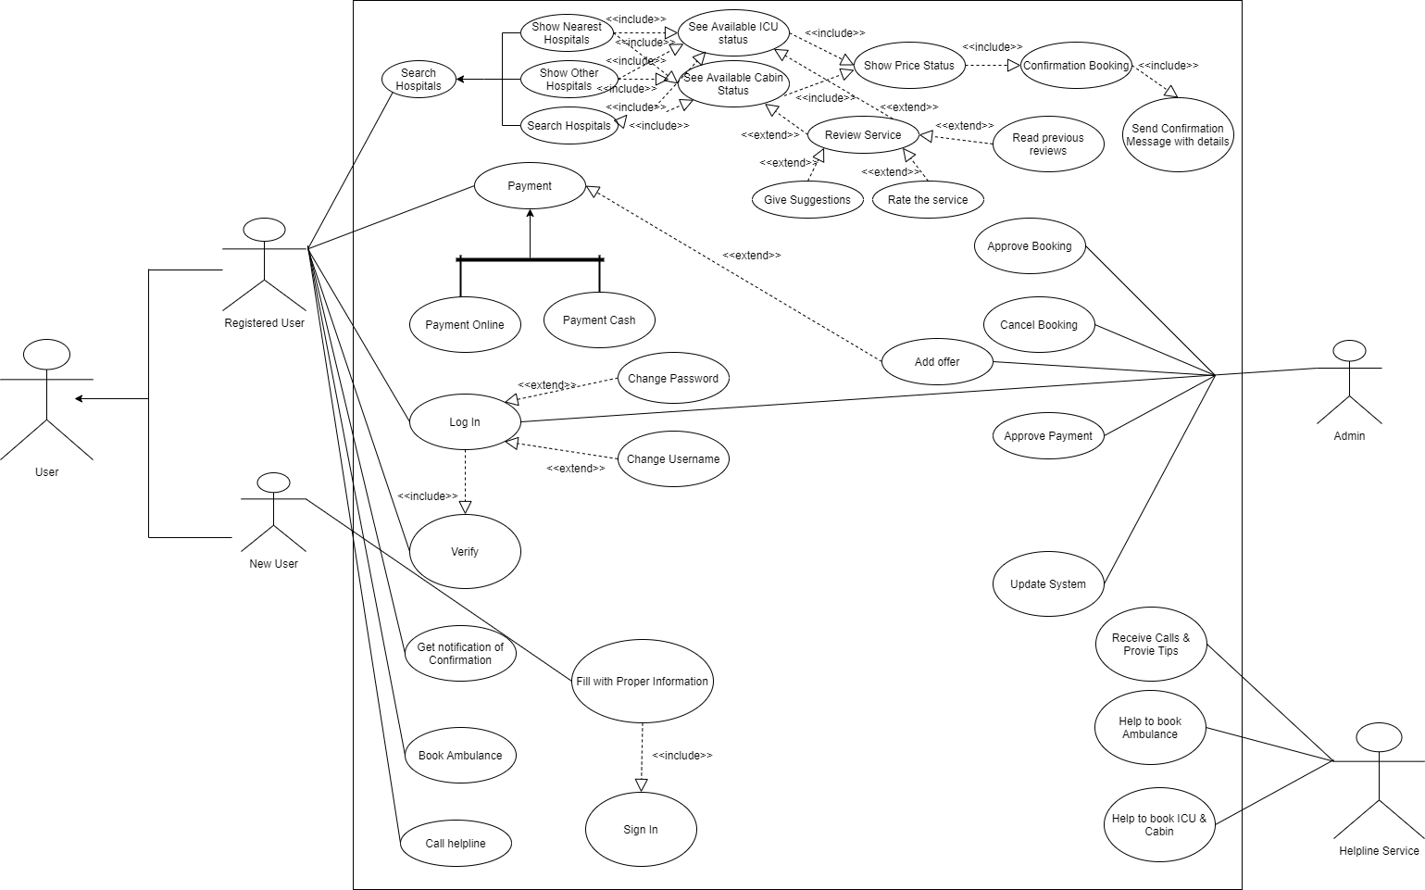
USE CASE DIAGRAM

Slide 14
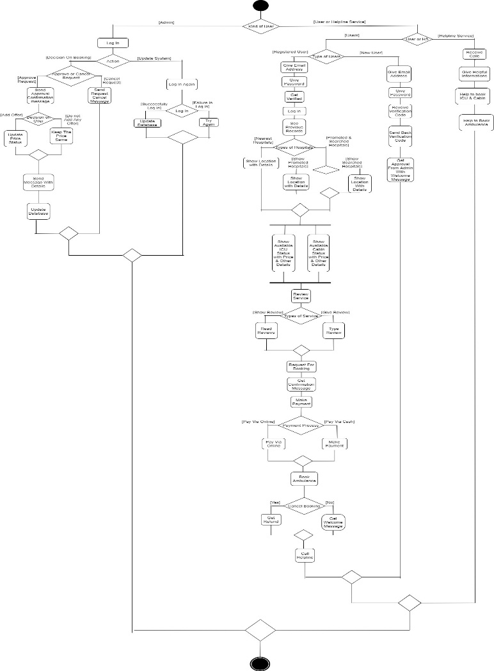
ACTIVITY DIAGRAM

Slide 15
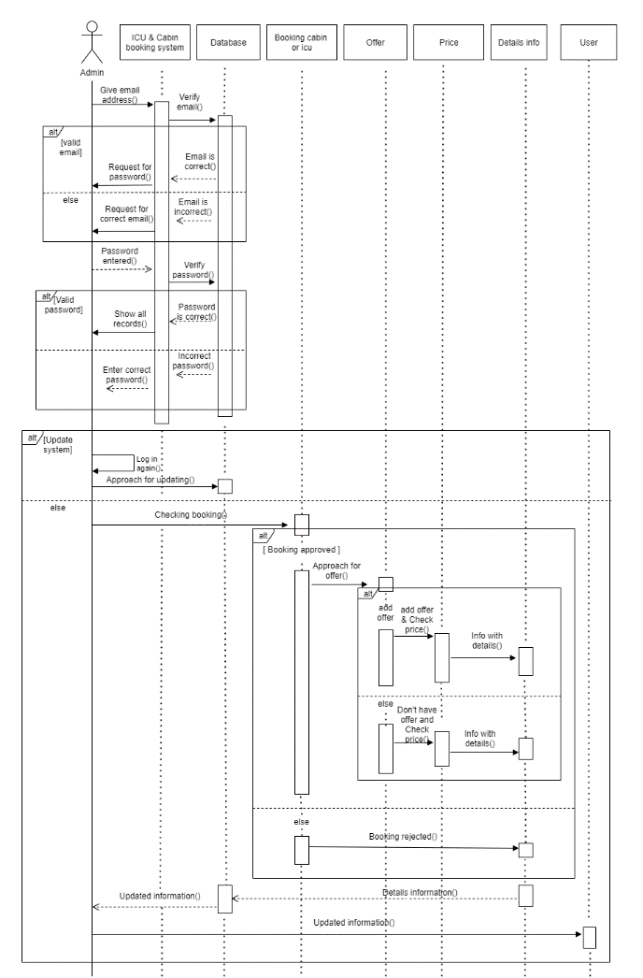
SEQUENCE DIAGRAM (ADMIN)

Slide 16
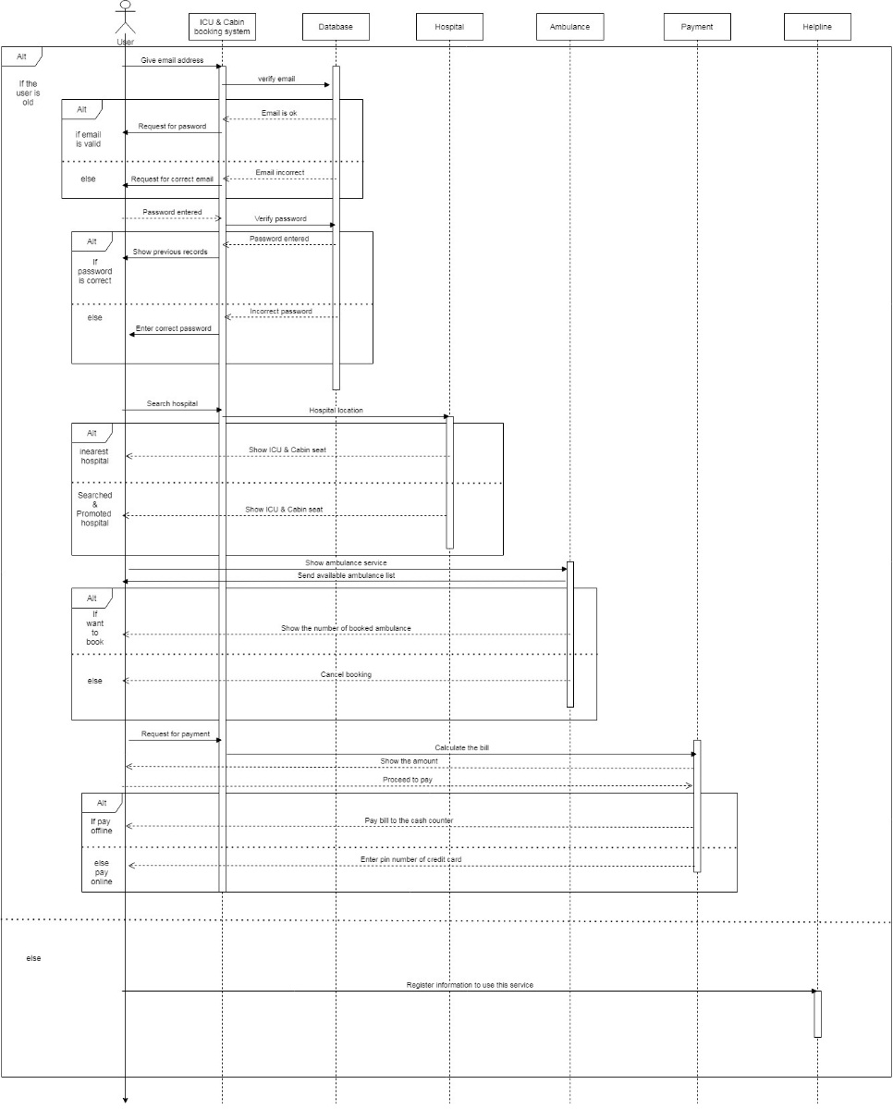
SEQUENCE DIAGRAM (USER)

Slide 17
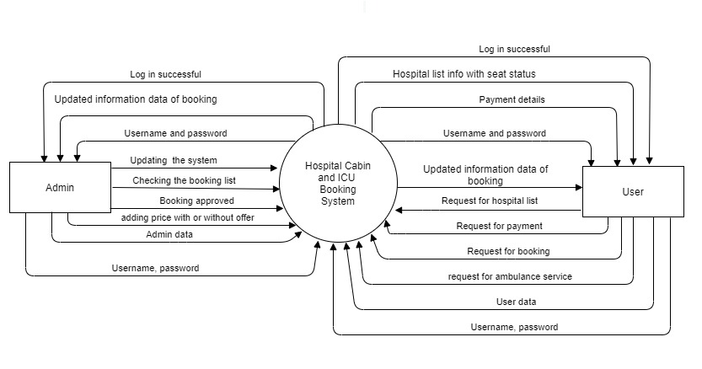
DATA FLOW DIAGRAM LEVEL-0

Slide 18
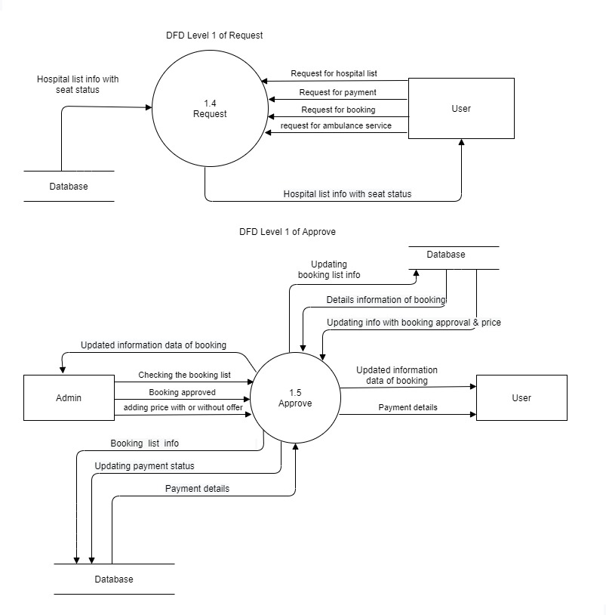
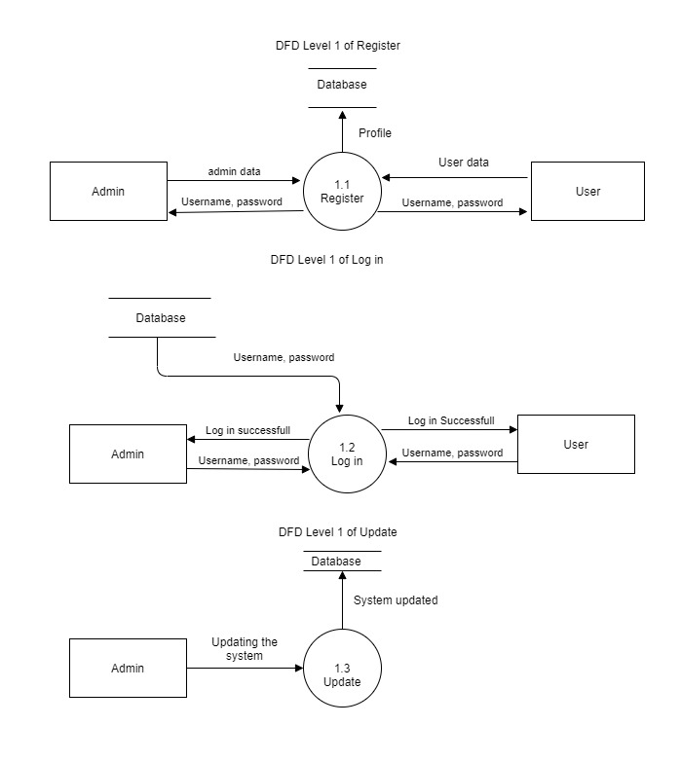
LEVEL-1

Slide 19
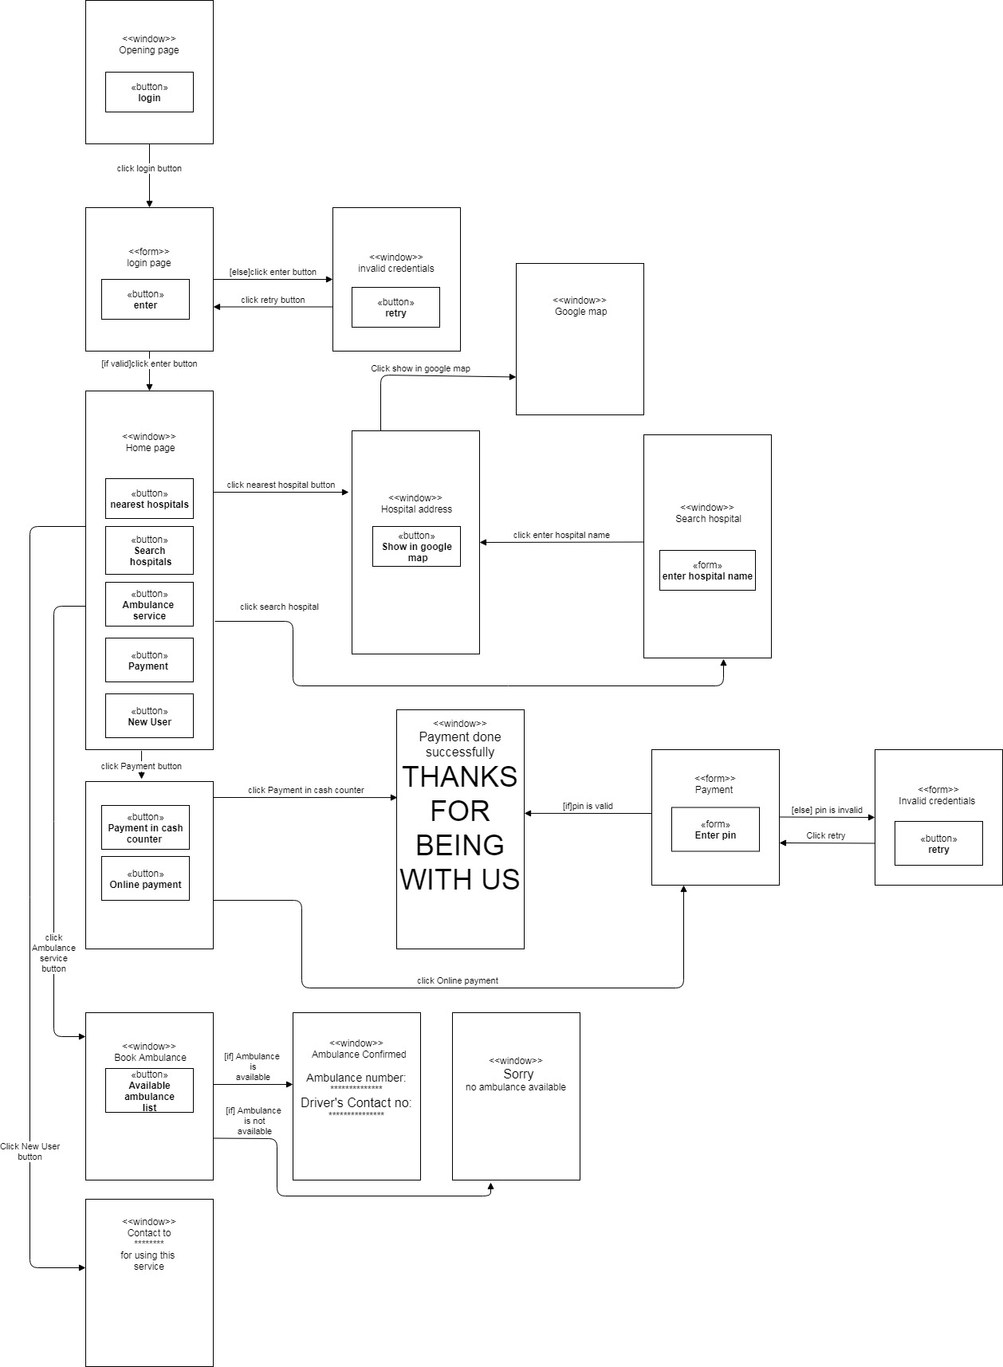
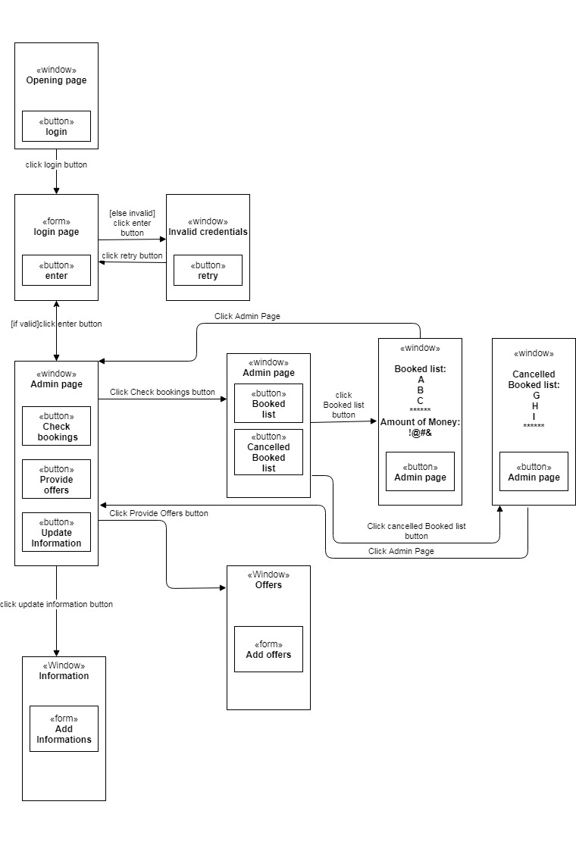
WINDOWS NAVIGATION DIAGRAM
Admin
User

Slide 20
SUMMARY & CONCLUSION
we believe that this system will help a number of people who are getting in huge trouble to find hospital cabin and ICU from their home. People can access this system from anywhere of the country and this system will be eligible to every corner of the country. And also hope that the system will revive the medical situation of our country slowly but surely.

Slide 21
Any Question?

Slide 22
Thank you

